Slide 1

Building Word2Vec embeddings A Harry Potter’s Perspective
Bryan Leow Xuan Zhen

Slide 2
Word Embeddings
To represent the meaning of words, we want words of similar meaning should have similar representation
Idea: View words as points or vectors in high-dimensional vector space, e.g. :
(0.02, 0.54, 1.93, -4.42…0.56)
Such vectors called word embeddings because they are embedded in a vector space.

Slide 3
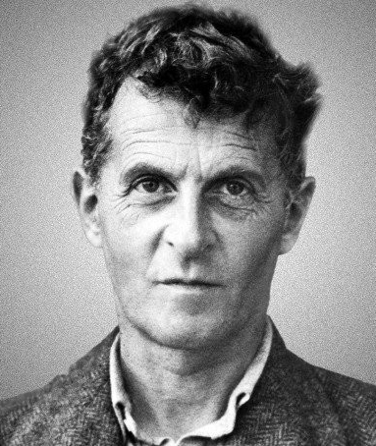
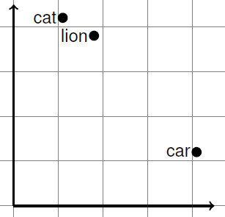
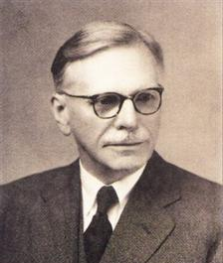

Distributional Hypothesis
The distributional hypothesis states that if 2 words $w_{1}$ and $w_{2}$ tend to co-occur with the same words, then $w_{1}$ and $w_{2}$ have a similar meaning.
Wittgenstein’s Philosophical Investigations:
“For a large class of cases–though not for all–in which we employ the word “meaning” it can be defined thus: the meaning of a word is its use in the language.”
John Rupert Firth:
“You shall know a word by the company it keeps.”

Slide 4
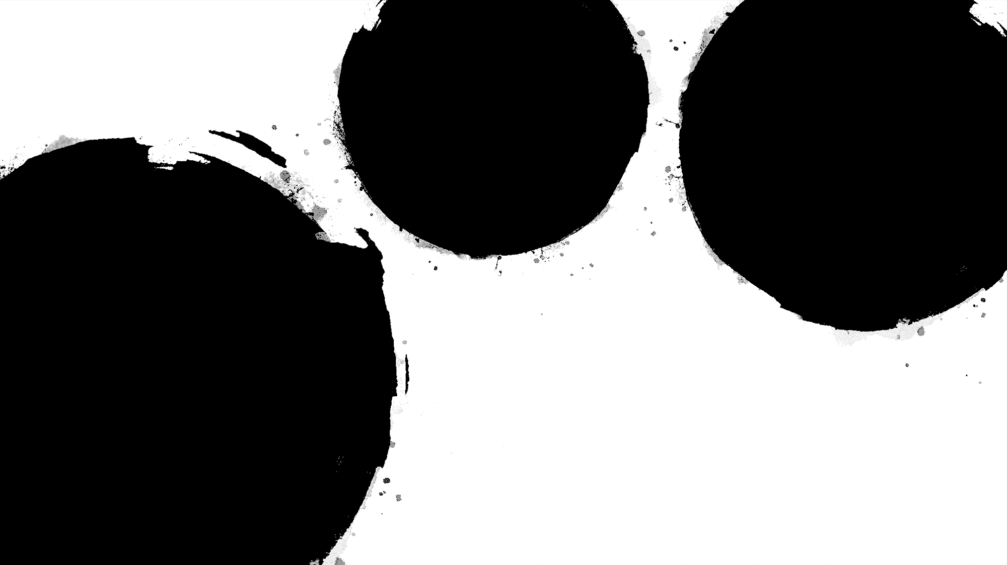
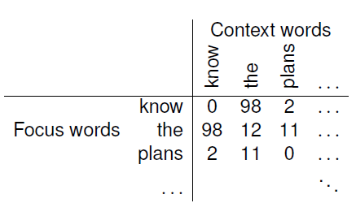
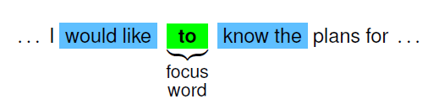
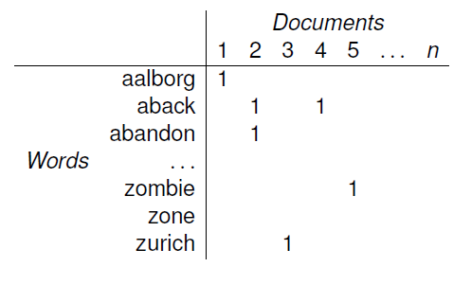
Ways of creating word embeddings
Word windows
Word-word matrix
Word-document matrix
Notes:
What meaning do such word vectors capture?
Vectors obtained from word-document matrices:
Words with similar vectors tend to belong to the same semantic field
E.g. hospital and nurse
Vectors obtained from word-word matrices:
Tend to capture both syntactic and semantic relationships
Problem with such word vectors: High-dimensional and sparse.
Solution: Dimensionality reduction technique, singular value decomposition etc.

Slide 5
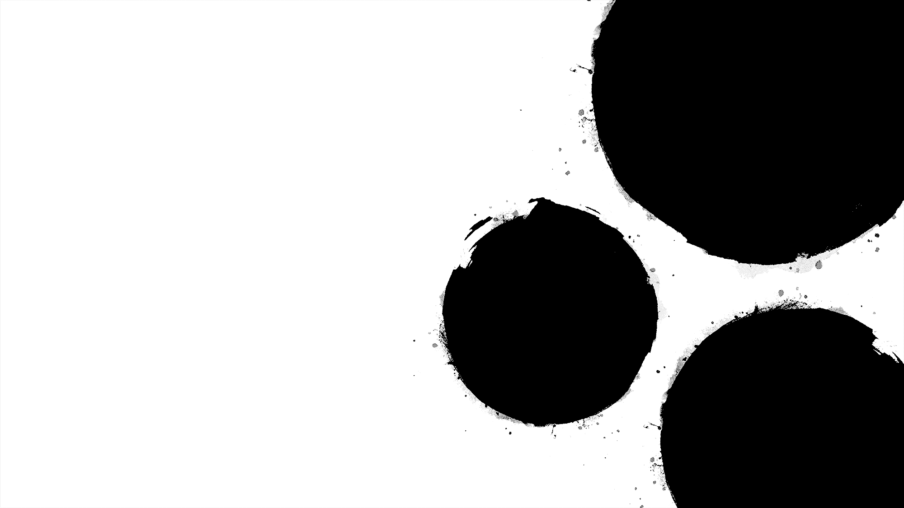
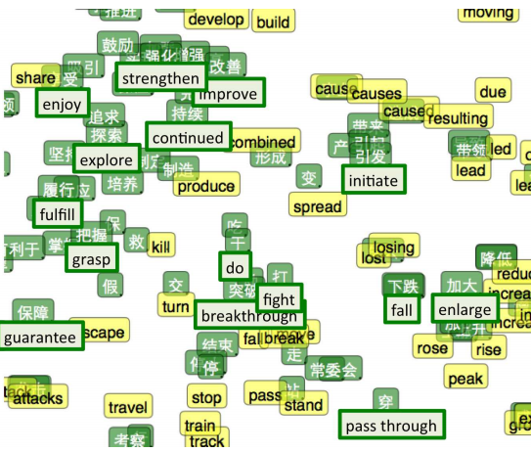
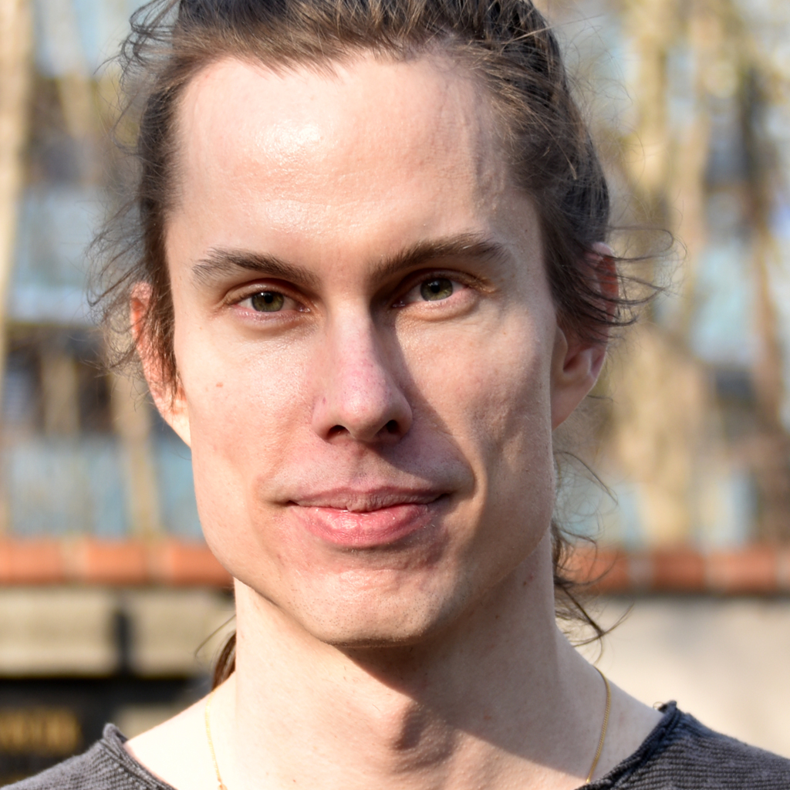

Word2Vec
One of the most popular technique to learn word embeddings using shallow neural network.
Developed by Thomas Mikolov in 2013 at Google.
Build word vectors for any language.
Quick, efficient
Word vectors trained with Word2Vec have many amazing features:
v(France) – v(Paris) + v(Rome) = v(Italy)
v(king) – v(man) + v(woman) = v(queen)
Starting point of neural network “revolution” in language engineering.

Slide 6
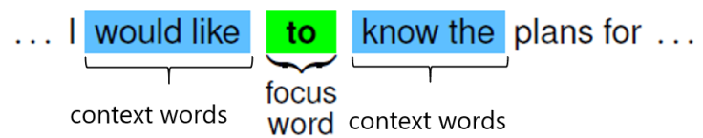
Word2Vec
Imagine a context window sliding over text:
Then we train a classifier that either:
Predict the focus word from the context words (continuous bag of words model)
Predict the context words from the focus word (skipgram model)
In this session, we will be looking at the skipgram model.
Note: Actually, we don’t care about the classifier. We are just interested in the trainable parameters of the model which will form our word vectors.

Slide 7
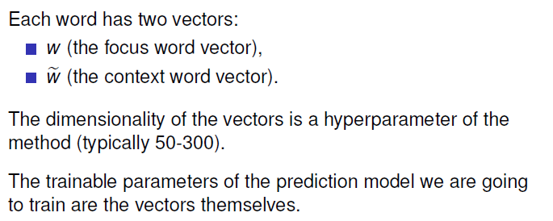
Word2Vec
Imagine a context window sliding over text:
Notes:
The more dimensions we have, the more fine-grained semantics distinction we can do between the words.
However, we will also need more training materials to get good quality vectors.
Content of the vectors will be the trainable parameters,
so if we have 50-dimensional vectors and each word has 2 vectors,
then each words have 100 trainable parameters.
If we have 10,000 words in our vocabulary, then we will have 1,000,000 train-able parameters.

Slide 8

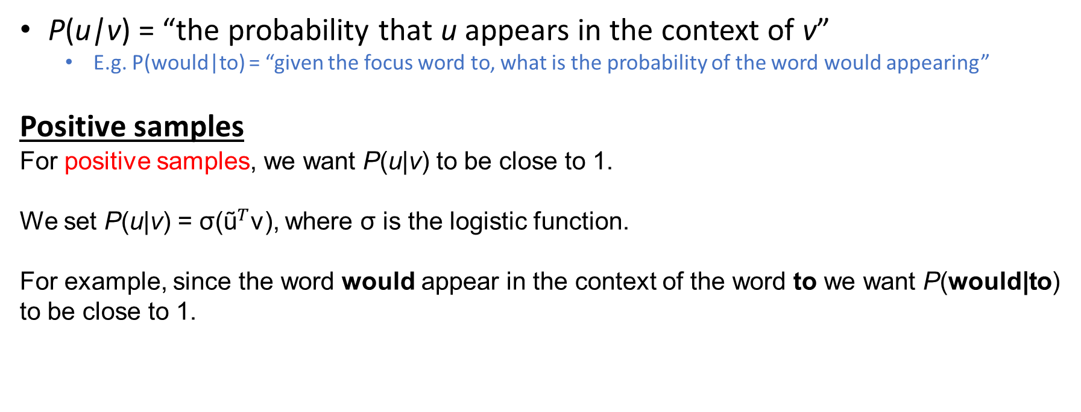
The skipgram prediction task Skipgram → predict context words from the focus word
P(u|v) = “the probability that u appears in the context of v”
E.g. P(would|to) = “given the focus word to, what is the probability of the word would appearing”
Positive samples
For positive samples, we want P(u|v) to be close to 1.
We set P(u|v) = σ(${\text{ũ}}^{T}$v), where σ is the logistic function.
For example, since the word would appear in the context of the word to we want P(would|to) to be close to 1.

Slide 9
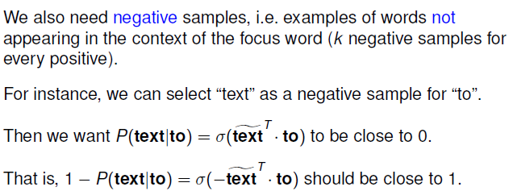

The skipgram prediction task Skipgram → predict context words from the focus word
P(u|v) = “the probability that u appears in the context of v”
E.g. P(would|to) = “given the focus word to, what is the probability of the word would appearing”
Negative Samples

Slide 10


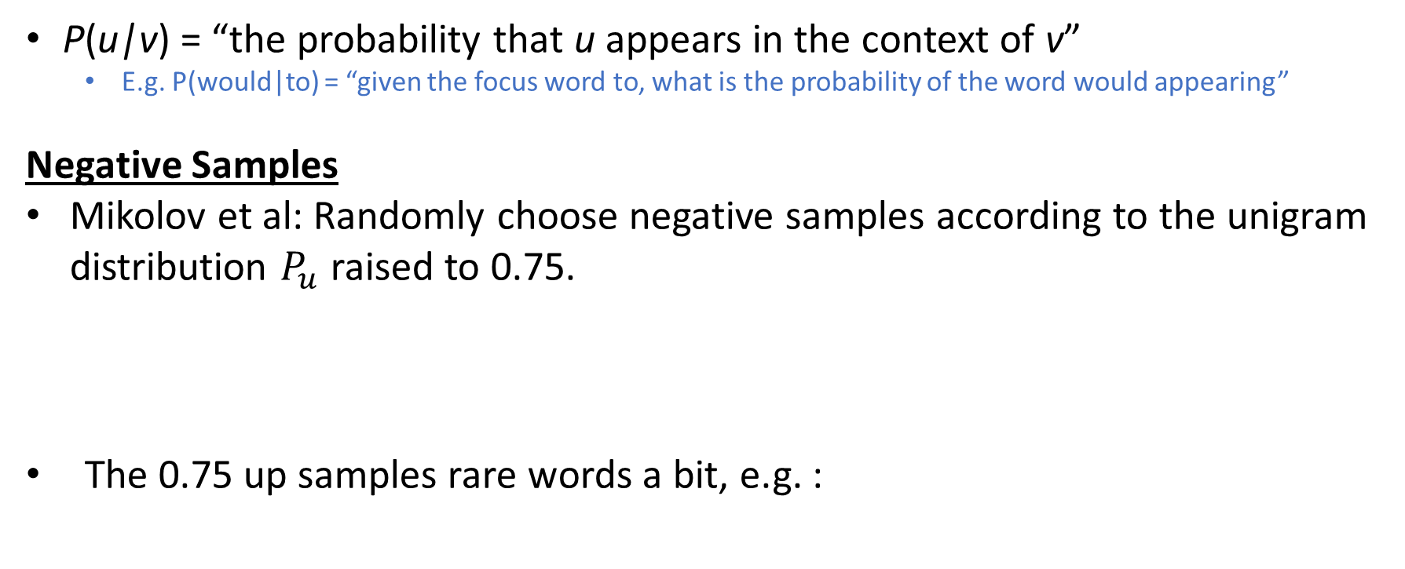
The skipgram prediction task Skipgram → predict context words from the focus word
P(u|v) = “the probability that u appears in the context of v”
E.g. P(would|to) = “given the focus word to, what is the probability of the word would appearing”
Negative Samples
Mikolov et al: Randomly choose negative samples according to the unigram distribution $P_{u}$ raised to 0.75.
The 0.75 up samples rare words a bit, e.g. :

Slide 11
Training procedure
Obtain a lot of running text
Decide the dimension for the vectors (e.g. 50)
For each word in the vocabulary, create one focus vector and one context vector, randomly initialised
Decide on the context window
E.g a context window of 2 will mean that the context words includes the 2 words to the left and 2 words to the right of the focus word

Slide 12
Training procedure
Obtain the positive and negative samples by moving through the text
For each positive sample, sample 5-20 negative samples
Positive samples: (to, would), (to, like), (to, know), (to, the)
Negative samples: (to, jelly), (to, giraffe) …
Use gradient descent to update the vectors for the focus word and the respective context words for both positive and negative sample
Move the word window one step to collect more positive and negative samples
Note: This is a form of semi-supervised learning since you get the labels of data points for free ☺

Slide 13
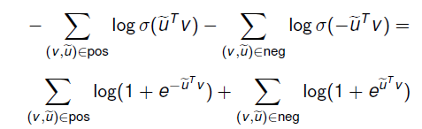
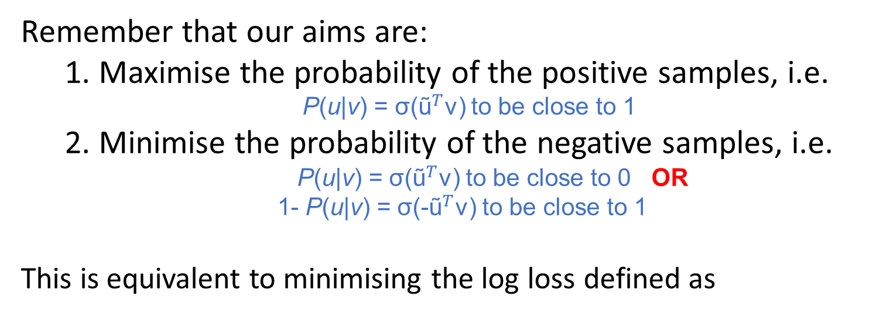
Loss Function
Remember that our aims are:
1. Maximise the probability of the positive samples, i.e.
P(u|v) = σ(${\text{ũ}}^{T}$v) to be close to 1
2. Minimise the probability of the negative samples, i.e.
P(u|v) = σ(${\text{ũ}}^{T}$v) to be close to 0 OR
1- P(u|v) = σ(-${\text{ũ}}^{T}$v) to be close to 1
This is equivalent to minimising the log loss defined as

Slide 14
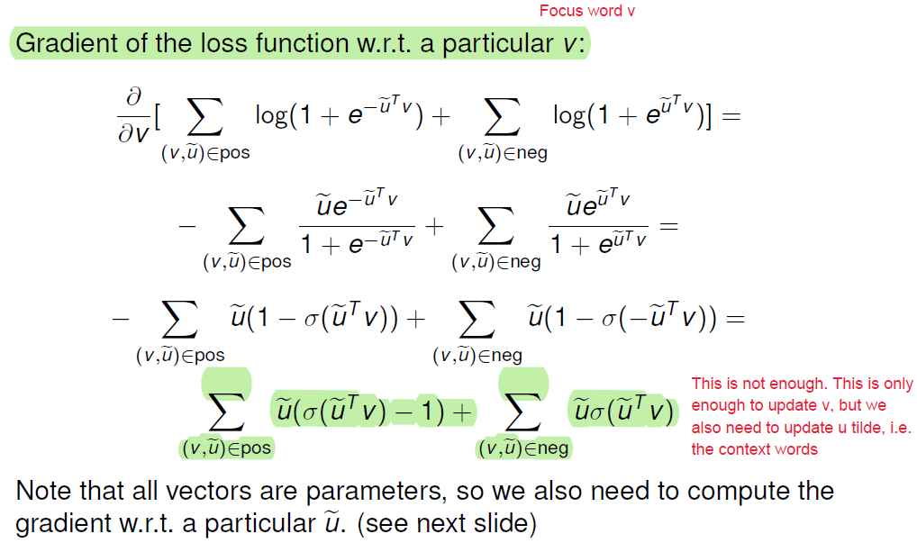
Gradient of Loss Function

Slide 15
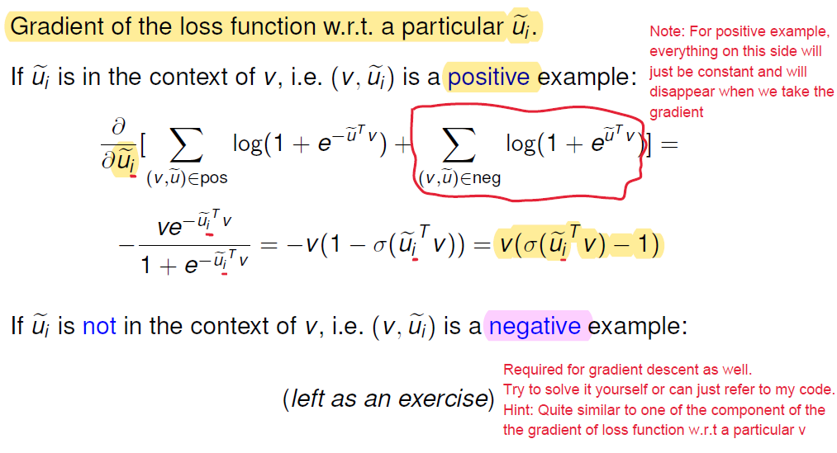
Gradient of Loss Function

Slide 16

Gradient of Loss Function
Basically, we need 3 gradients:
Gradient of loss function w.r.t focus word v
Gradient of loss function w.r.t to ${\text{ũ}}_{i}$ where ${\text{ũ}}_{i}$ is a context word
Gradient of loss function w.r.t to ${\text{ũ}}_{i}$ where ${\text{ũ}}_{i}$ is not a context word

Slide 17
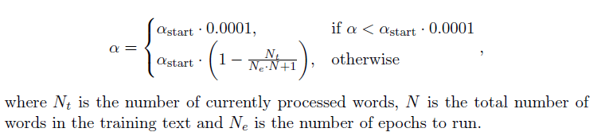
Learning Rate Scheduler

Slide 18
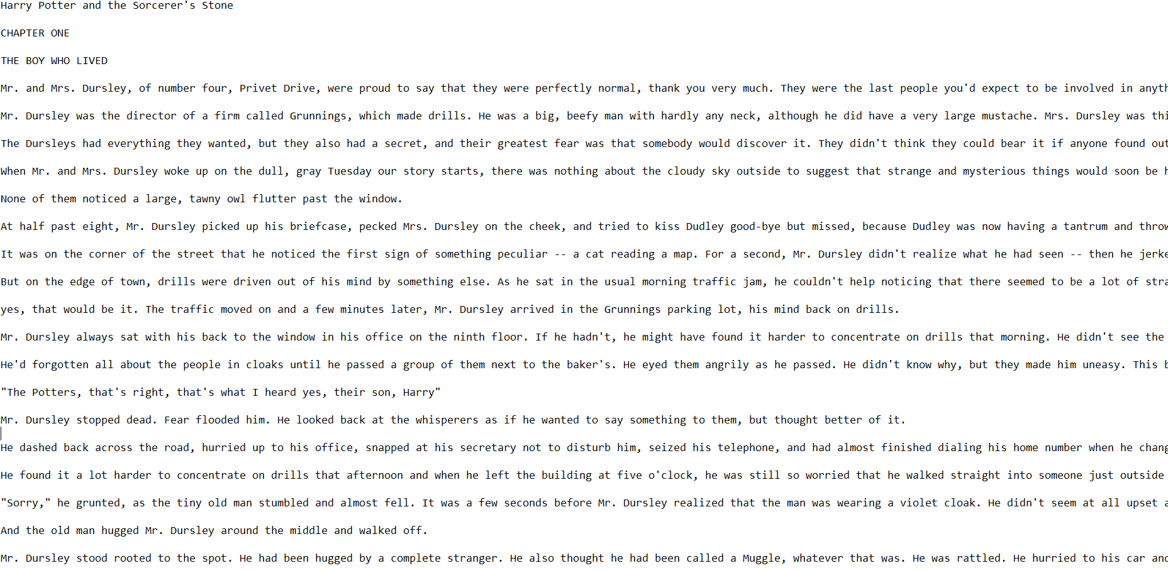
Main Task
Build a word2Vec embeddings from Harry Potter and the Sorcerer's Stone

Slide 19
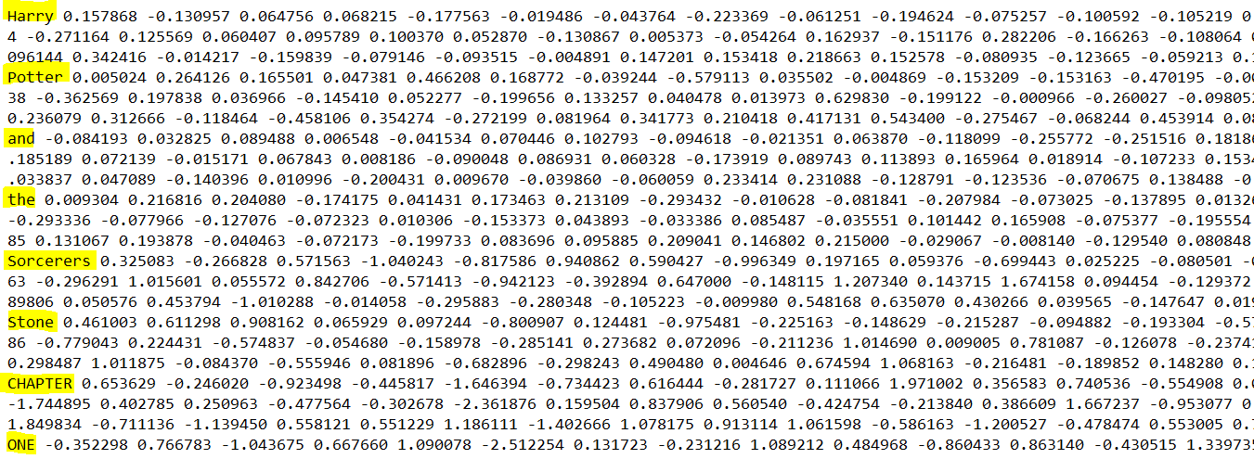
Main Task
Build a word2Vec embeddings from Harry Potter and the Sorcerer's Stone

Slide 20
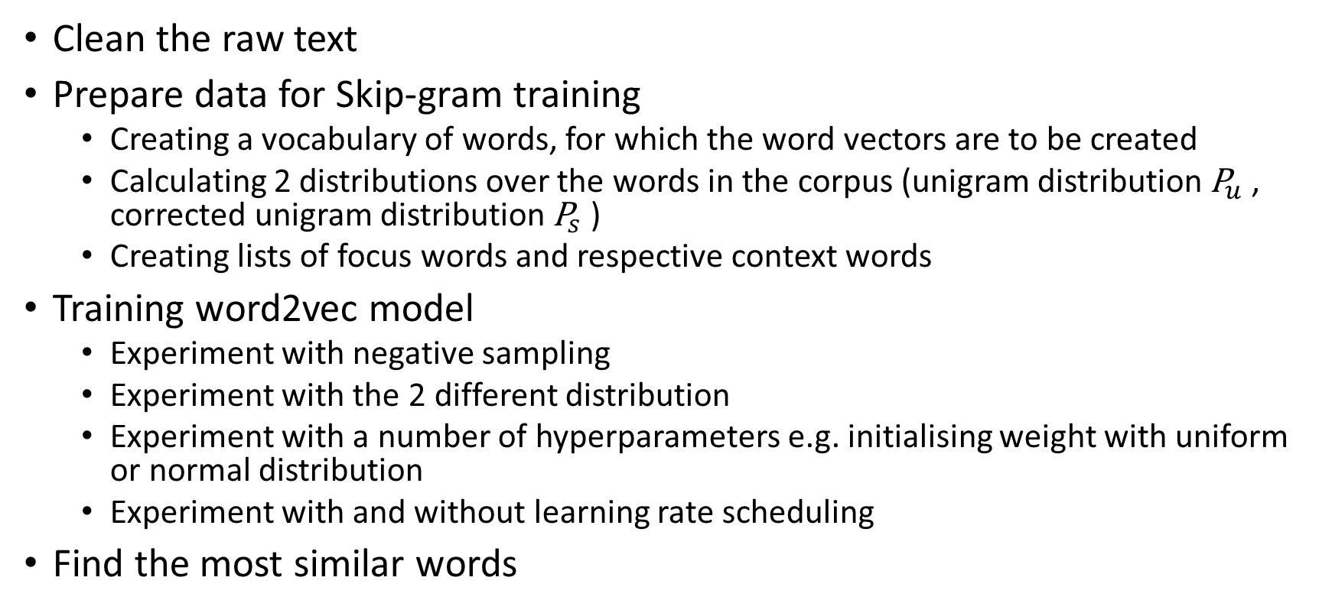
Sub Tasks
Clean the raw text
Prepare data for Skip-gram training
Creating a vocabulary of words, for which the word vectors are to be created
Calculating 2 distributions over the words in the corpus (unigram distribution ${\text{P}}_{u}$ , corrected unigram distribution ${\text{P}}_{s}$ )
Creating lists of focus words and respective context words
Training word2vec model
Experiment with negative sampling
Experiment with the 2 different distribution
Experiment with a number of hyperparameters e.g. initialising weight with uniform or normal distribution
Experiment with and without learning rate scheduling
Find the most similar words
For source code: https://github.com/blxz96/DD2418-Language-Engineering/tree/master/Assignment%203

Slide 21
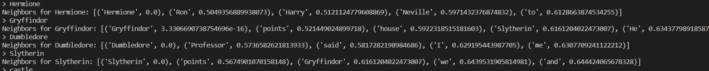
Training process
Results

Slide 22
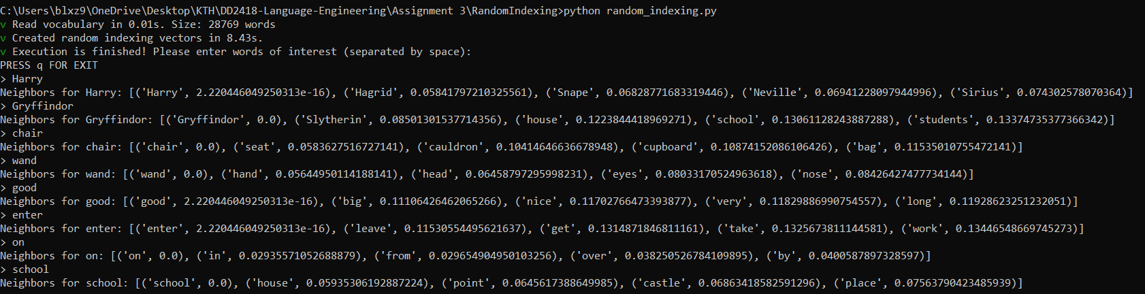
Results of other embeddings (Random Indexing, Glove etc.)

